Slide 1
Modul - Internet of Things (IoT) - 04-Vorlesung
Prof. Dr. Marcel Tilly
Fakultät Informatik, Cloud Computing

Slide 2
Überblick
21. März Einführung in das Internet der Dinge
28. März IoT Architekturen
4. April Things und Sensoren
11. April From Device to Cloud
18. April Vorlesungsfrei – Ostern
25. April IoT Analytics
02. Mai Big Data in IoT
9. Mai Data Exploration
16. Mai IoT Platformen
23. Mai Entwicklung einer IoT Lösung
30. Mai Vorlesungsfrei; Christi Himmelfahrt
05. Juni opt. Gastvortrag – Digitalisierung
13. Juni Data Science in IoT
20. Juni Vorlesungsfrei – Fronleichnam
27. Juni Intelligente Cloud und intelligente Edge
04. Juli PStA Abschlusspraesentationen
PStA

Slide 3
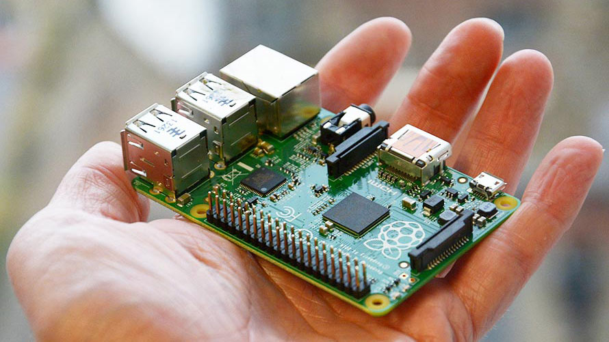
What is Raspberry Pi ?
Arguably the most popular single board computer (SBC)
Easy to get started with because basically every problem is documented
Add a computer with a OS to practically anything
NOTE: Do not expect it to perform as well as your laptop
Support for a vast array of peripherals (thanks to the Linux kernel)
USB devices, networking, displays, cameras, audio etc.

Slide 4
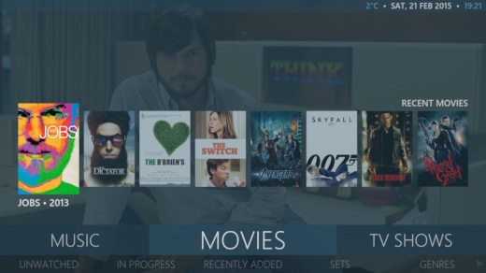

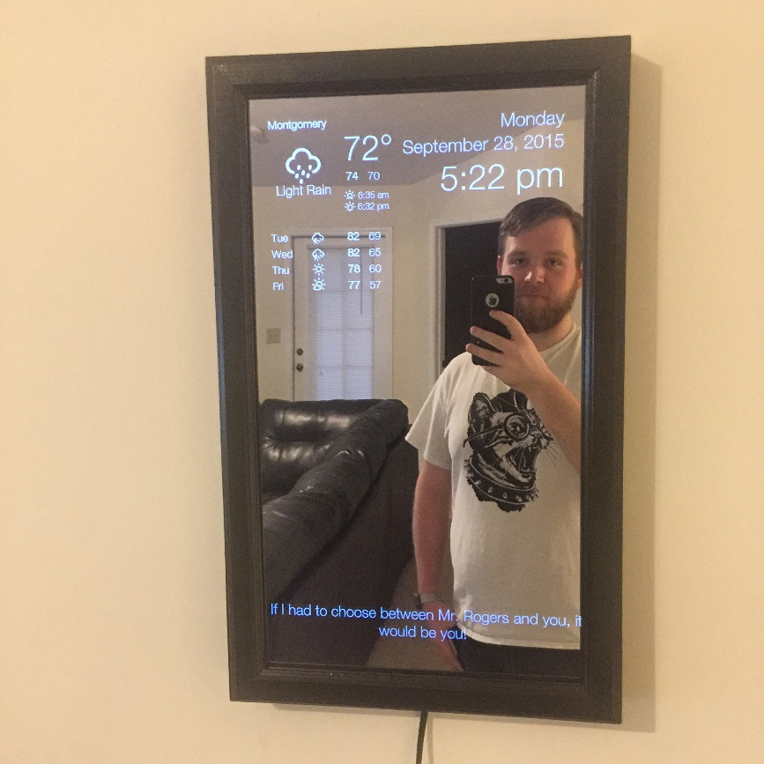
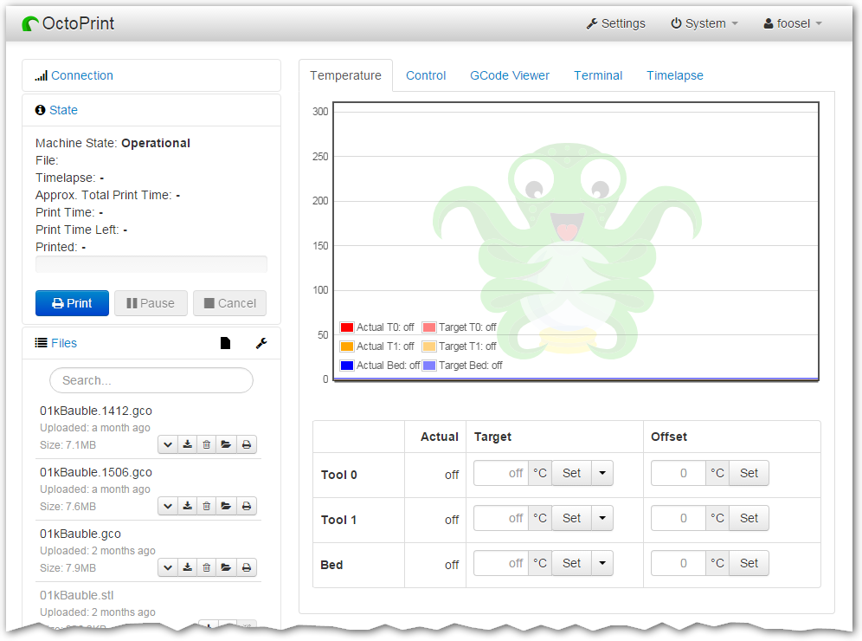
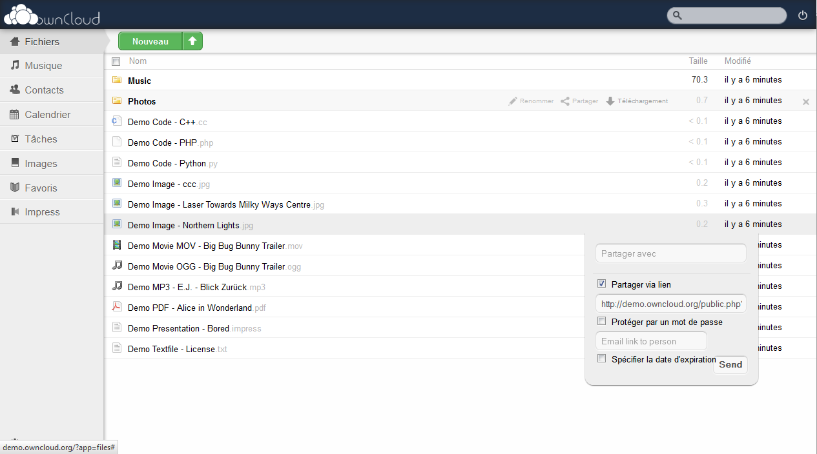
What can you do with a Pi? (not so cool)
http://mymediaexperience.com/raspberry-pi-xbmc-with-raspbmc/
https://learn.adafruit.com/pigrrl-2/overview
https://www.raspberrypi.org/magpi/magic-mirror/
https://github.com/foosel/OctoPrint
https://vadelmapii.com/blogi/yllapida-omaa-dropbox-kloonia-raspberry-pilla-kayttaen-owncloudia

Slide 5
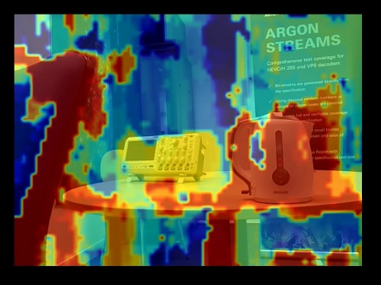
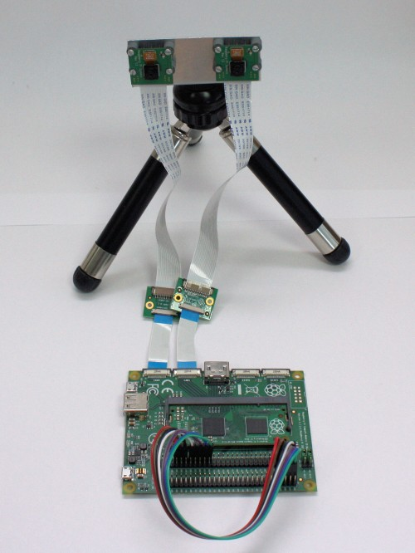
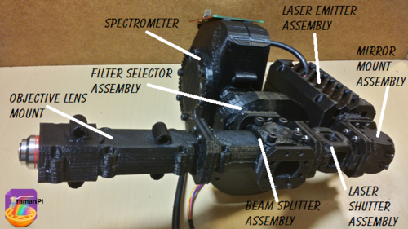
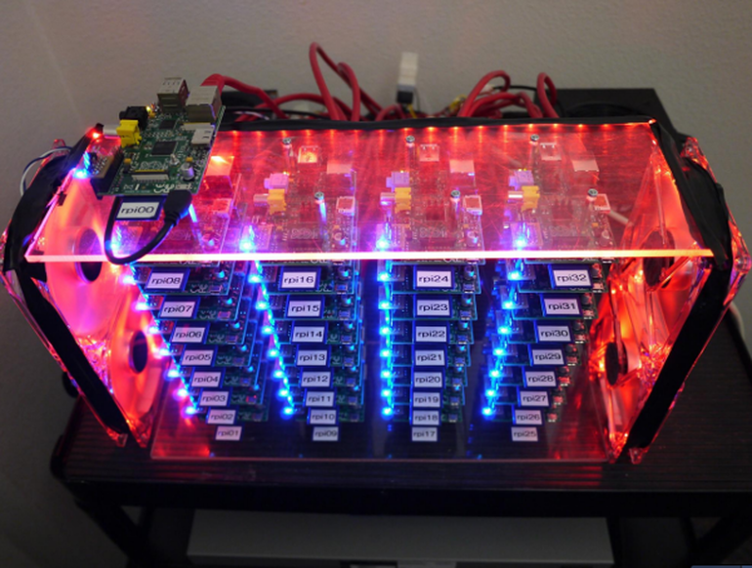
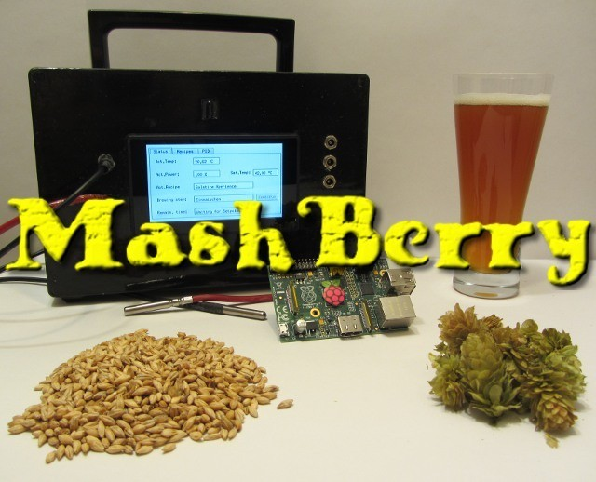
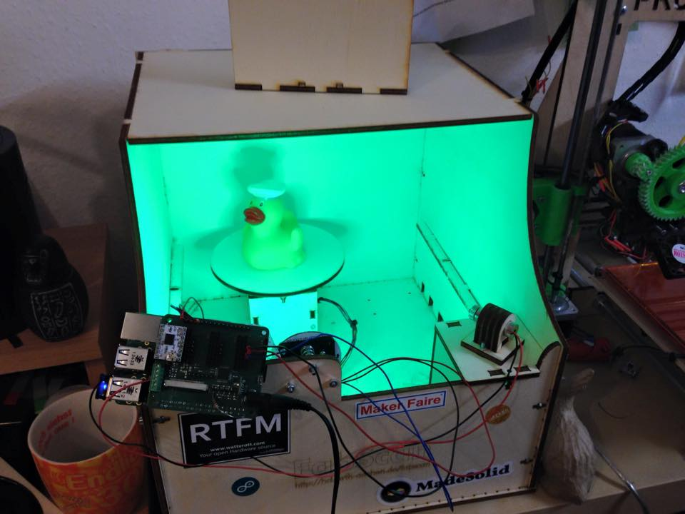
What can you do with a Pi? (cool)
https://www.raspberrypi.org/blog/real-time-depth-perception-with-the-compute-module/
https://hackaday.io/project/1279-ramanpi-raman-spectrometer
https://www.raspberrypi.org/blog/real-time-depth-perception-with-the-compute-module/
http://www.zdnet.com/article/build-your-own-supercomputer-out-of-raspberry-pi-boards/
https://hackaday.io/project/1269-mashberry-beer-brewing-with-raspberry-pi
https://www.raspberrypi.org/magpi/fabscan-pi-project-3d-scanning-for-all/

Slide 6
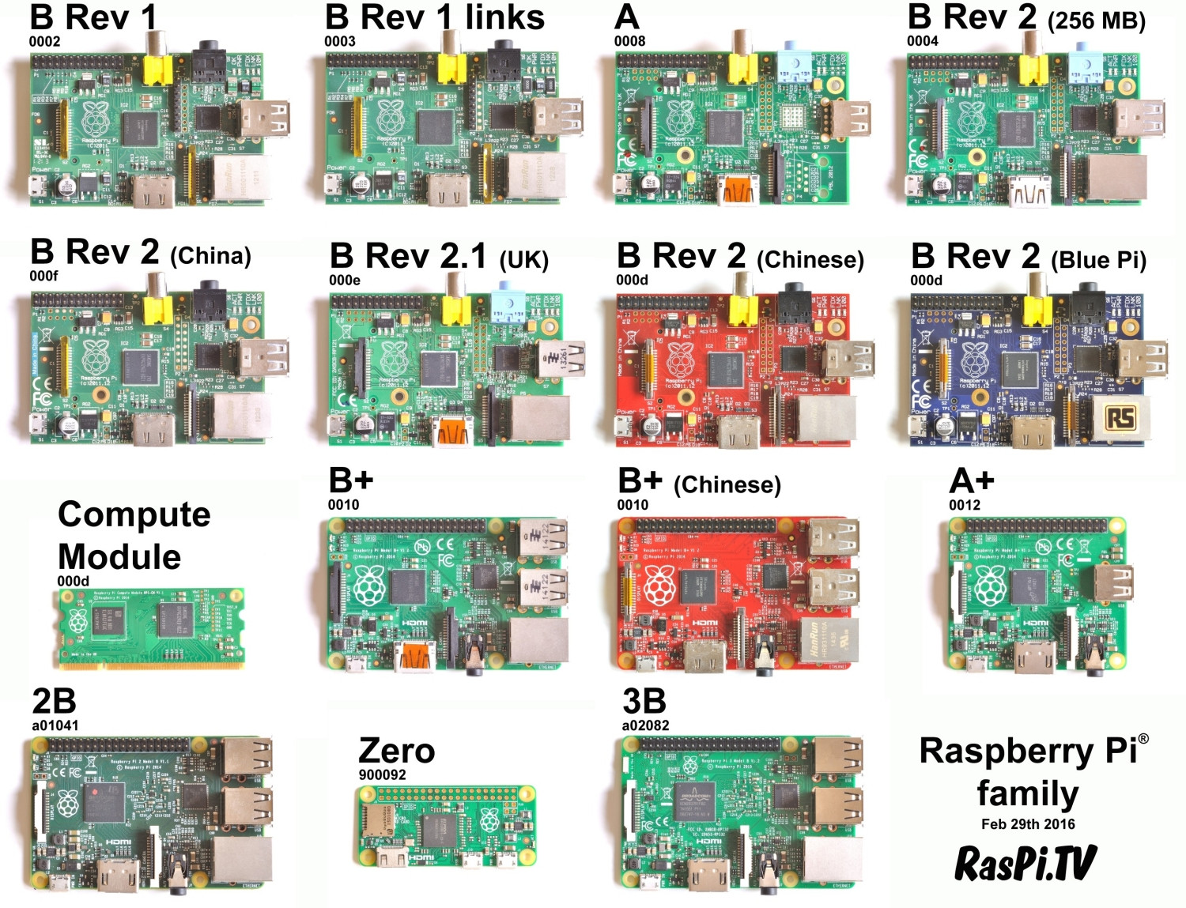
Raspberry Pi models

Slide 7
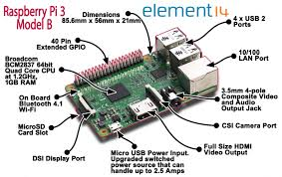
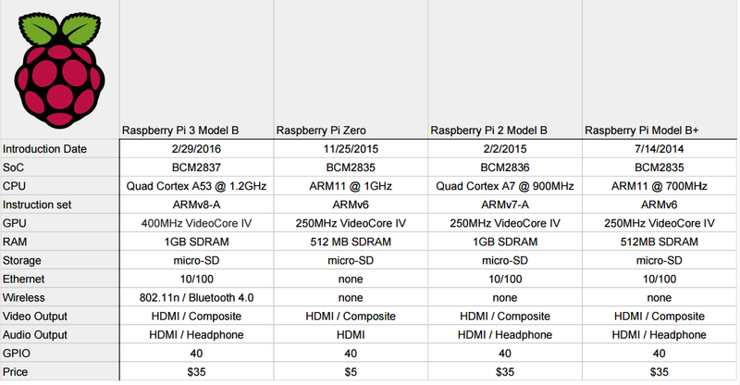
Plattform: Raspberry Pi

Slide 8
Raspberry Pi advantages and disadvantages
Cheap (price per performance)
Well documented
Availability
Also in terms of add-ons (HATs)
Versatile
Compact (especially Zero)
Scary linux (learning required)
Not real time*
No ADC (easy to add though)
PWM possible but limited frequency
* It is possible to install a RTOS on the Pi

Slide 9



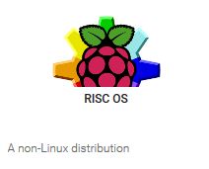







OS options
with Pixel or Lite

Slide 10
Installation process
Get SD card (micro on newer Pi’s)
Format to FAT32 (for example with SD card formatter)
Using NOOBS:
Download NOOBS (sd-cards with pre-installed NOOBS can purchased)
Unzip and copy all contents to SD card (takes a while)
Boot
Using a disk image writer:
Download the disk image (.img)
Write the disk image on the SD card (“hard drive”)
Windows: Win32 disk image writer or Etcher
MacOSX / Linux: Use dd (or image writer with GUI such as Etcher)
Boot

Slide 11
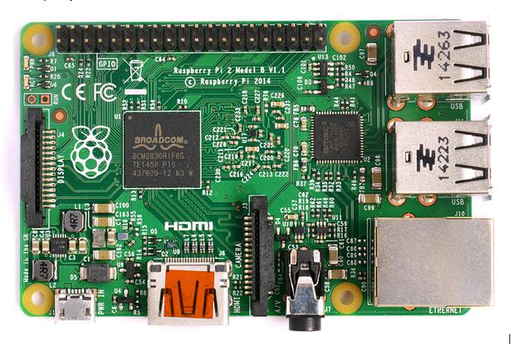
Connections
GPIO
MicroSD-slot
(underneath)
4x USB 2.0
Display connector
Micro USB for power (min. 5V/1A)
Ethernet
3.5mm Audio/Video Jack
HDMI
Camera connector

Slide 12
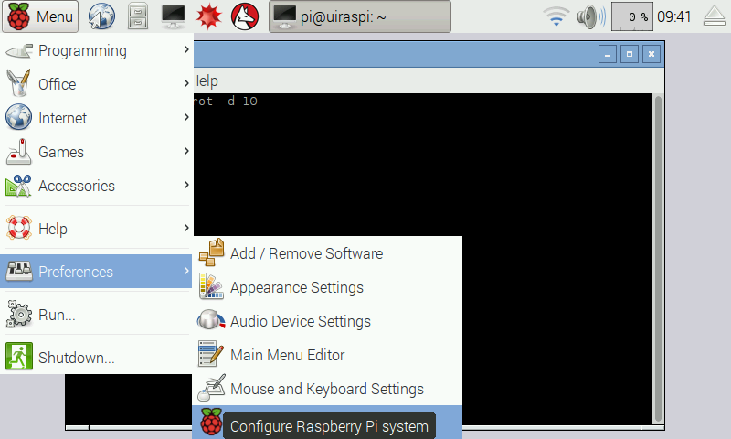
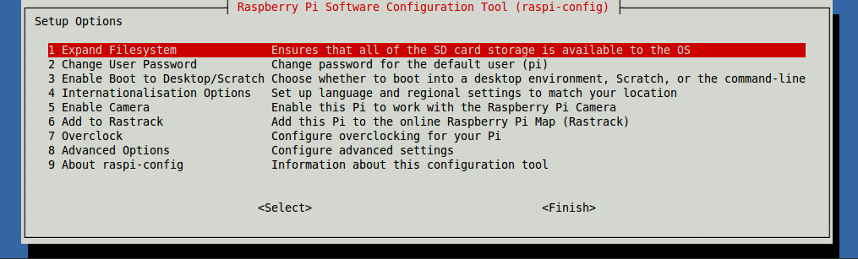
On first boot…
NOOBS installer has GUI (Raspbian recommended)
Boots into raspi-config (you can run it with “sudo raspi-config”)
Expand file system, change password and change keyboard layout, enable ssh etc.

Slide 13
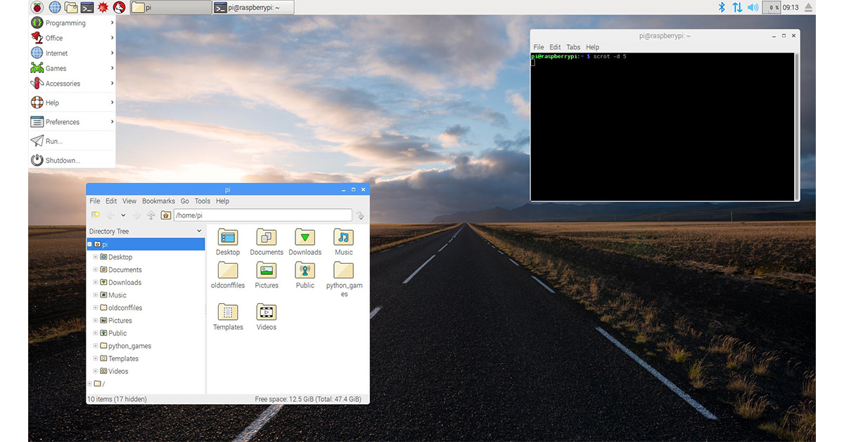
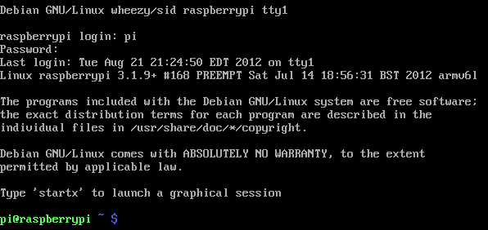
Terminal or Pixel
There are two options when booting: shell or Pixel desktop (graphical session)

Slide 14
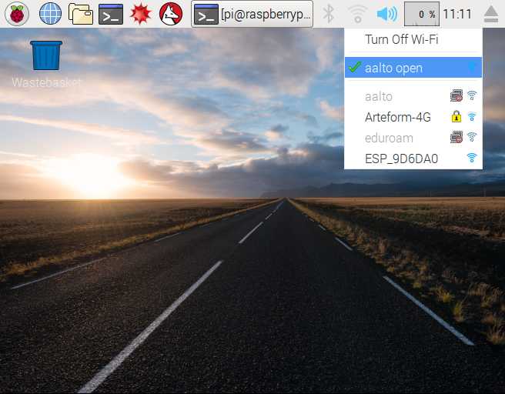
Connect to WLAN
In GUI:
Choose WiFi network and connect
Without GUI :
sudo iwlist wlan0 scan // scan for networks
sudo nano /etc/wpa_supplicant/wpa_supplicant.conf // open wpa_supplicant configuration
Add this to the bottom of the file
network={
ssid=“aalto open"
proto=RSN
key_mgmt=NONE
}

Slide 15
Data Storage
Challenges
Technology
Amount of Data (Big Data) - Volume
Speed of Data (Data Rate) - Velocity
Data format (semantics) - Variety
Data trust
Data quality
DSVGO (privacy)
Encryption (Transport security)
Compression
Data Selection
SQL
Map-and-Reduce (Hadoop)
Stream Processing (Spark)

Slide 16
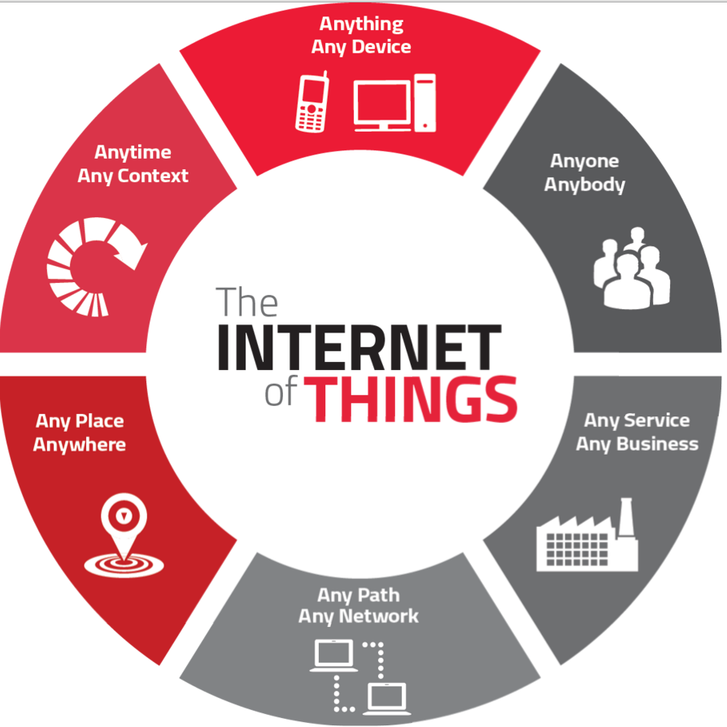

IoT Meets Big Data

Slide 17
When does data become Big Data
Big data is generally defined by its “three Vs”: volume, velocity, and variety. Thinkers in the field have occasionally argued for adding additional “Vs” (such as veracity and value), but the classic three Vs provide a nice overview of what defines big data.
Volume is the “big” in big data. Current volumes of data (4 zettabytes worldwide this year and growing) dwarf anything we have had to tackle in human history.
Velocity refers to the rate at which big data needs to be processed. This is both a factor of how quickly new data gets created, but also that we often want to look at live data streams for fresh data, like Twitter feeds for sentiment analysis or real-time Internet of Things (IoT) sensor data streams.
Variety refers to unstructured (images, audio, and the like) or semi-structured (JSON documents).
Notes:
Big data is generally defined by its “three Vs”: volume, velocity, and variety. Thinkers in the field have occasionally argued for adding additional “Vs” (such as veracity and value), but the classic three Vs provide a nice overview of what defines big data.
Volume is the “big” in big data. Current volumes of data (4 zettabytes worldwide this year and growing) dwarf anything we have had to tackle in human history.
Velocity refers to the rate at which big data needs to be processed. This is both a factor of how quickly new data gets created, but also that we often want to look at live data streams for fresh data, like Twitter feeds for sentiment analysis or real-time Internet of Things (IoT) sensor data streams.
Variety refers to unstructured (images, audio, and the like) or semi-structured (JSON documents).

Slide 18
Big Data Value Chain
Collection
Ingestion
Discovery & Cleansing
Integration
Analysis
Delivery
Collection – Structured, unstructured and semi-structured data from multiple sources
Ingestion – loading vast amounts of data onto a single data store
Discovery & Cleansing – understanding format and content; clean up and formatting
Integration – linking, entity extraction, entity resolution, indexing and data fusion
Analysis – Intelligence, statistics, predictive and text analytics, machine learning
Delivery – querying, visualization, real time delivery on enterprise-class availability
18

Slide 19

Azure Big Data platform Transform data into intelligent actions and predictions
Data
Intelligence
Action
Information management
Big data stores
Machine learning and analytics
Intelligence
Data Sources
Microsoft Cognitive Services
People
Azure Data Factory
Azure Data Lake Store
Azure Machine Learning
Bot Framework
Cortana
Azure Data Catalog
Azure SQL Data
Warehouse
Azure Data Lake Analytics
Web
Business scenarios
Apps
Azure Cosmos DB
Azure HDInsight (Apache Hadoop and Apache Spark)
Recommendations,
customer churn,
forecasting, and so on
Azure Event Hubs
Apps
Mobile
Apache Kafka for HD Insight
Azure SQL Database
Azure Stream Analytics
Dashboards and visualizations
Bots
Azure Analysis Services
Sensors and devices
R
Microsoft R Server
Microsoft Power BI
Automated systems
Notes:
Azure offers a complete suite of services that help you build your build your own Big Data solution – from acquiring data to transforming it into new insights and action.
Let’s start with your data. You need a platform with scale, simplicity, and flexibility. Azure allows you to pull together massive amounts of data through services like Event Hubs and Data Factory.
Your data might come from a public data source like local transportation data or it might come from sensors - thermostats that produce telemetry data every few minutes – or app performance counters that generate events every second, and mobile apps that capture telemetry for every customer’s action.
Data is meaningless unless you do something with it, so chances are you’re going to want humans to take action from it, whether you express it as a new dashboard, a more intelligent app user experience, or a new algorithm that automates a process.
There are entire suites of tools in the cloud that allow you to ingest data, store data, analyze data, visualize data, and act on insights from data

Slide 20



From(data).To(insights)
3Vs: Volume, Variety, Velocity
Structured
SQL
SQL Azure
SQL Table
Semi
structured
Hadoop
Map&Reduce
Data Lake
Event
Data Streams
Low-latency
High-throughput
In-flight
Advanced Analytics (Machine Learning)
Predictive Maintenance, Early-Fault-Detection, Idle Prediction

Slide 21
Understanding Streaming Data (1)
Question: “How many red cars are in the parking lot?”
Prerequisite: Data is static! (no cars leaving or entering!)
Answering with a relational database:
Walk out to the parking lot
Count vehicles that are: ‘Red’ and ‘Cars’
(FROM vhcl in ParkingLot
WHERE vhcl.type = “CAR”
&& vhld.color = “RED”
SELECT vhcl).Count()

Slide 22
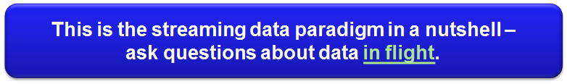
Understanding Streaming Data (2)
“How many trucks (red cars) went from right to left in the last 10 seconds”?
“How many green cars (= electrical cars) are passing every 60 minutes”?
“What is the running average speed of cars on the left lane compared to the right lane?

Slide 23
Data Stream in a Nutshell
A data stream is a continuous sequence of data tuples
Think of standard tuples of relational databases
+ time information (timestamp = TS)
That means:
Data is moving!
Continuously generated (assumed infinite!)
Potentially high pace.
System has to process data without first storing everything
TS
TS
TS
TS
TS
TS
TS
Tuple
Tuple
Tuple
Tuple
Tuple
Tuple
Tuple
time t

Slide 24
Data Stream Scenarios
Sensor networks for environmental monitoring
Avalanche risk level computation
Insights for agriculture
Air pollution (urban) monitoring
Real-time analysis of stock market changes
Computing statistics over streams, e.g., for decision support
Opportunities for reacting in real-time
Even with fully automated means: algorithmic trading
Social Media Analysis
Sentiment analysis of products
News and trend analysis
Industrial monitoring
Energy consumption and other key performance indicators (KPIs)
Predictive maintenance

Slide 25
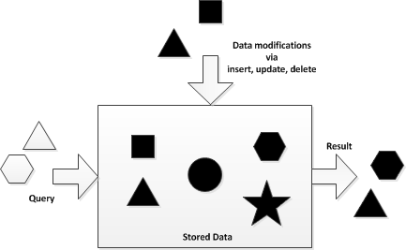
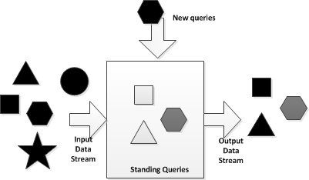
Streaming Data Paradigm
 | Database Applications | Data Streaming Applications
Concept | Persist data (&relations) (Data at Rest) | Volatile data streams (Data in Motion)
Strategy | Random access | Sequential access
Query Paradigm | Ad-hoc queries or requests | Continuous standing queries
Memory/Storage | (in theory) unlimited storage | Main memory limitations
Execution Time | Little or no time requirements (Seconds, hours, days) | Consideration of the order of the input (< 1 sec.)
Data Rate | Low rate (Hundreds of events/sec) | High rate (tens of thousands of events/sec or more)
Query Semantics | Declarative relational analytics | Declarative relational and temporal analytics
Accuracy | Assumes exact data | Assumes inaccurate data

Slide 26
Data Stream Terminology
Term | Notation | Description | Technology Sample
Tuple/ payload | p = <k1:v1, k2:v2, …> | A un-ordered list of named elements (e.g. JSON)
Event | e = <ts, p> | A timestamped tuple
Stream | s | A stream is a possibly infinite sequence of events
Source | src |> s | A source is emitting continuously events | Storm: Spout StreamInsight: IObservable
Operator | S_{1,in} .. S_{n,in}|> o |> s_{1,out}…S_{m,out} | Processor of n input streams producing m output stream of events | Storm: Bolt StreamInsight: Function
Topology | G = (src[1..n], o, sk) | A graph of calculation represented as a network (= query) with n sources and 1 sink
Sink | s |> sk | Consumes results of a Stream | StreamInsight: IObserver

Slide 27
Data Stream Topology
A standing query is an instance of a topology (=query graph)
A data stream engine handles heavy lifting for data streams
Data Stream Engine
Source2
Join
Source1
Filter
Project
Sink
Sourcen
Filter
Project
Sink
Input
Standing Queries
Output

Slide 28
Query Expressiveness
Stream Operations
Selection of events = filter
Calculations on the tuple payload = projection
Correlation of streams = join
Stream partitioning = grouping
Window Operations
Aggregation (sum, count, min, max…) over event windows
Ranking over event windows (topK)
User defined functions
window
TS
TS
TS
TS
TS
TS
TS
Tuple
Tuple
Tuple
Tuple
Tuple
Tuple
Tuple
time t

Slide 29
Query Expressiveness
var result = from e in inputStream
where e.id > 3
select new {
id = e.id,
W = (double)e.intW / 10 };
Filter
Projection
Correlation (Join)
Projection
var result = from eLeft in inputStream1
join eRight in inputStream2
on eLeft.id equals eRight.id
select new {
id = eLeft.id,
diff = eLeft.W - eRight.w };

Slide 30
Time Windows
A 10-second tumbling window
1
5
4
6
2
8
6
5
3
6
1
0
5
10
15
20
25
30
Time (seconds)
1
5
4
6
2
8
6
5
3
6
1
How many vehicles entered each toll both every 10 seconds?
SELECT TollId, COUNT(*) FROM EntryStream
TIMESTAMP BY EntryTime
GROUP BY TollId, TumblingWindow(second,10)

Slide 31
Time Windows
A 10-second Hopping Window with a 5-second “Hop”
1
5
4
6
2
8
7
5
3
6
1
0
5
10
15
20
25
30
1
5
4
6
2
4
6
2
8
6
8
6
5
3
5
3
6
1
Report every 5 seconds the total weight of cars that entered each toll both in the past 10 seconds
SELECT TollId, SUM(VehicleWeight) AS TotalWeight
FROM EntryStream TIMESTAMP BY EntryTime
GROUP BY TollId, HoppingWindow(second, 10 , 5)

Slide 32
Windows
Entry
1
5
0
5
10
15
20
25
Exit
1
5
1
1
5
5
Report all toll booths which have served more than 3 vehicle in the last 10 seconds
SELECT TollId, Count(*)
FROM EntryStream TIMESTAMP BY EntryTime
GROUP BY TollId, SlidingWindow(second, 10)
HAVING COUNT(*) > 3

Slide 33
Joining multiple streams
Calculate the time required for each car to pass the toll
(in maximum 15 minutes)
Toll Entry :
{“YZB 1245”, 3}
{“TYU 4587”, 7}
{“WAA 3423”, 2}
{“AB 2678”, 3}
Toll Exit :
{“YZB 1245”, 3}
{“WAA 3423”, 2}
{“TYU 4587”, 7}
{“AB 2678”, 3}
time
SELECT EN.LicensePlate, DATEDIFF(minute, EN.EntryTime, EX.ExitTime) AS TotalTime
FROM EntryStream EN TIMESTAMP BY EntryTime
JOIN ExitStream EX TIMESTAMP BY ExitTime
ON EN.TollId = EX.TollId AND EN.LicensePlate = EX.LicensePlate AND DATEDIFF(minute, EN, EX) BETWEEN 0 AND 15

Slide 34
Detecting absence of events
Report all cars that did not pass the toll booth within 5 minutes
Toll Entry :
{“YZB 1245”, 3}
{“TYU 4587”, 7}
{“WAA 3423”, 2}
{“AB 2678”, 3}
Toll Exit :
{“YZB 1245”, 3}
{“WAA 3423”, 2}
{“AB 2678”, 3}
time
SELECT EN.LicensePlate, EN.TollId FROM EntryStream EN TIMESTAMP BY EntryTime
LEFT OUTER JOIN ExitStream EX TIMESTAMP BY ExitTime
ON EN.TollId = EX.TollId AND EN.LicensePlate = EX.LicensePlate AND DATEDIFF(minute, EN, EX) BETWEEN 0 AND 5
WHERE EX.ExitTime IS NULL

Slide 35
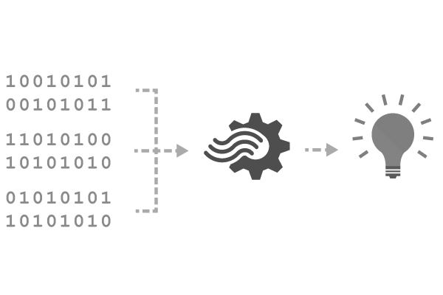
Reference Data
Seamless correlation of event streams with reference data
Static or slowly-changing data stored in blobs
Scanned for changes on a settable cadence
JOIN (INNER or LEFT OUTER) between streams and reference data sources
Reference data appears like another input in the query
SELECT myRefData.Name, myStream.Value
FROM myStream
JOIN myRefData
ON myStream.myKey = myRefData.myKey
Notes:
Next thing is the concept of reference data. This is very important because people want to shrink payload down because you are transporting data over network, GPRS etc.. they only send data that is very relevant. Payload might only look like sensor A, temp x. But, you need to know where this sensor maps to – in other words, where this located, which manufacturer did we get it from etc – in case it fails etc., So this is called reference data. This is data at rest. In ASA we let you add reference data. You can treat reference data as another stream to further augment your streaming data. Right now we only support reference data in Blobs. Can refresh these blobs @ 5 min frequency. Working actively on adding SQL. All I need to – instead of 2 streaming inputs – 1 ref data, 1 streams, Use same joins on reference data, AND augment the data before storing it. By the way, this is one of the more used features. You can refresh the blob too.

Slide 36
Technologies
Apache Spark: Fast and general engine for large-scale data processing
Apache Storm: Distributed real-time computation system to reliably process unbounded streams of data
Apache Flink: Scalable stream and batch processing
Apace Ignite: In-memory computing platform
Commercial:
Tibco Event Stream Processing
IBM Streams
Microsoft StreamInsight/ Azure Stream Analytics
Amazon AWS Kinesis Analytics

